Slide 1

William Stallings Computer Organization and Architecture 10th Edition
Notes:
Lecture slides prepared for “Computer Organization and Architecture”, 10/e, by William Stallings, Chapter 2 “Performance Issues”.

Slide 2
Chapter 2
Performance Issues
Notes:
This chapter addresses the issue of computer system performance. We begin with a
consideration of the need for balanced utilization of computer resources, which provides
a perspective that is useful throughout the book. Next we look at contemporary
computer organization designs intended to provide performance to meet current
and projected demand. Finally, we look at tools and models that have been developed
to provide a means of assessing comparative computer system performance.

Slide 3
Designing for Performance
The cost of computer systems continues to drop dramatically, while the performance and capacity of those systems continue to rise equally dramatically
Today’s laptops have the computing power of an IBM mainframe from 10 or 15 years ago
Processors are so inexpensive that we now have microprocessors we throw away
Desktop applications that require the great power of today’s microprocessor-based systems include:
Image processing
Three-dimensional rendering
Speech recognition
Videoconferencing
Multimedia authoring
Voice and video annotation of files
Simulation modeling
Businesses are relying on increasingly powerful servers to handle transaction and database processing and to support massive client/server networks that have replaced the huge mainframe computer centers of yesteryear
Cloud service providers use massive high-performance banks of servers to satisfy high-volume, high-transaction-rate applications for a broad spectrum of clients
Notes:
Year by year, the cost of computer systems continues to drop dramatically, while the
performance and capacity of those systems continue to rise equally dramatically.
Today’s laptops have the computing power of an IBM mainframe from 10 or 15
years ago. Thus, we have virtually “free” computer power. Processors are so inexpensive
that we now have microprocessors we throw away. The digital pregnancy test is
an example (used once and then thrown away). And this continuing technological
revolution has enabled the development of applications of astounding complexity
and power. For example, desktop applications that require the great power of
today’s microprocessor-based systems include
■ Image processing
■ Three-dimensional rendering
■ Speech recognition
■ Videoconferencing
■ Multimedia authoring
■ Voice and video annotation of files
■ Simulation modeling
Workstation systems now support highly sophisticated engineering and scientific
applications and have the capacity to support image and video applications. In addition,
businesses are relying on increasingly powerful servers to handle transaction
and database processing and to support massive client/server networks that have
replaced the huge mainframe computer centers of yesteryear. As well, cloud service
providers use massive high-performance banks of servers to satisfy high-volume,
high-transaction-rate applications for a broad spectrum of clients.
What is fascinating about all this from the perspective of computer organization
and architecture is that, on the one hand, the basic building blocks for today’s
computer miracles are virtually the same as those of the IAS computer from over
50 years ago, while on the other hand, the techniques for squeezing the maximum
performance out of the materials at hand have become increasingly sophisticated.
This observation serves as a guiding principle for the presentation in this
book. As we progress through the various elements and components of a computer,
two objectives are pursued. First, the book explains the fundamental functionality
in each area under consideration, and second, the book explores those techniques
required to achieve maximum performance. In the remainder of this section, we
highlight some of the driving factors behind the need to design for performance.

Slide 4
Microprocessor Speed
Techniques built into contemporary processors include:
Pipelining
Processor moves data or instructions into a conceptual pipe with all stages of the pipe processing simultaneously
Branch prediction
Processor looks ahead in the instruction code fetched from memory and predicts which branches, or groups of instructions, are likely to be processed next
Data flow analysis
Processor analyzes which instructions are dependent on each other’s results, or data, to create an optimized schedule of instructions
Speculative execution
Using branch prediction and data flow analysis, some processors speculatively execute instructions ahead of their actual appearance in the program execution, holding the results in temporary locations, keeping execution engines as busy as possible
Superscalar execution
This is the ability to issue more than one instruction in every processor clock cycle. (In effect, multiple parallel pipelines are used.)
Notes:
What gives Intel x86 processors or IBM mainframe computers such mind-boggling
power is the relentless pursuit of speed by processor chip manufacturers. The evolution
of these machines continues to bear out Moore’s law, mentioned previously. So
long as this law holds, chipmakers can unleash a new generation of chips every three
years—with four times as many transistors. In memory chips, this has quadrupled
the capacity of dynamic random-access memory (DRAM), still the basic technology
for computer main memory, every three years. In microprocessors, the addition of
new circuits, and the speed boost that comes from reducing the distances between
them, has improved performance four- or fivefold every three years or so since Intel
launched its x86 family in 1978.
But the raw speed of the microprocessor will not achieve its potential unless
it is fed a constant stream of work to do in the form of computer instructions.
Anything that gets in the way of that smooth flow undermines the power of the
processor. Accordingly, while the chipmakers have been busy learning how to fabricate
chips of greater and greater density, the processor designers must come up with
ever more elaborate techniques for feeding the monster. Among the techniques
built into contemporary processors are the following:
Pipelining:
The execution of an instruction involves multiple stages of operation,
including fetching the instruction, decoding the opcode, fetching operands,
performing a calculation, and so on. Pipelining enables a processor to
work simultaneously on multiple instructions by performing a different phase
for each of the multiple instructions at the same time. The processor overlaps
operations by moving data or instructions into a conceptual pipe with all
stages of the pipe processing simultaneously. For example, while one instruction
is being executed, the computer is decoding the next instruction. This is
the same principle as seen in an assembly line.
• Branch prediction:
The processor looks ahead in the instruction code fetched
from memory and predicts which branches, or groups of instructions, are likely
to be processed next. If the processor guesses right most of the time, it can
prefetch the correct instructions and buffer them so that the processor is kept
busy. The more sophisticated examples of this strategy predict not just the
next branch but multiple branches ahead. Thus, branch prediction increases
the amount of work available for the processor to execute.
• Superscalar execution:
This is the ability to issue more than one instruction
in every processor clock cycle. In effect, multiple parallel pipelines are used.
• Data flow analysis:
The processor analyzes which instructions are dependent
on each other’s results, or data, to create an optimized schedule of instructions.
In fact, instructions are scheduled to be executed when ready, independent of
the original program order. This prevents unnecessary delay.
• Speculative execution:
Using branch prediction and data flow analysis, some
processors speculatively execute instructions ahead of their actual appearance
in the program execution, holding the results in temporary locations.
This enables the processor to keep its execution engines as busy as possible by
executing instructions that are likely to be needed.
These and other sophisticated techniques are made necessary by the sheer
power of the processor. Collectively they make it possible to execute many instructions
per processor cycle, rather than to take many cycles per instruction.

Slide 5
Improvements in Chip Organization and Architecture
Increase hardware speed of processor
Fundamentally due to shrinking logic gate size
More gates, packed more tightly, increasing clock rate
Propagation time for signals reduced
Increase size and speed of caches
Dedicating part of processor chip
Cache access times drop significantly
Change processor organization and architecture
Increase effective speed of instruction execution
Parallelism
Notes:
As designers wrestle with the challenge of balancing processor performance with that
of main memory and other computer components, the need to increase processor
speed remains. There are three approaches to achieving increased processor speed:
• Increase the hardware speed of the processor. This increase is fundamentally
due to shrinking the size of the logic gates on the processor chip, so that more
gates can be packed together more tightly and to increasing the clock rate.
With gates closer together, the propagation time for signals is significantly
reduced, enabling a speeding up of the processor. An increase in clock rate
means that individual operations are executed more rapidly.
• Increase the size and speed of caches that are interposed between the processor
and main memory. In particular, by dedicating a portion of the processor
chip itself to the cache, cache access times drop significantly.
• Make changes to the processor organization and architecture that increase the
effective speed of instruction execution. Typically, this involves using parallelism
in one form or another.

Slide 6
Problems with Clock Speed and Login Density
Power
Power density increases with density of logic and clock speed
Dissipating heat
RC delay
Speed at which electrons flow limited by resistance and capacitance of metal wires connecting them
Delay increases as the RC product increases
As components on the chip decrease in size, the wire interconnects become thinner, increasing resistance
Also, the wires are closer together, increasing capacitance
Memory latency
Memory speeds lag processor speeds
Notes:
Traditionally, the dominant factor in performance gains has been in increases
in clock speed due and logic density. However, as clock speed and logic density
increase, a number of obstacles become more significant [INTE04b]:
• Power: As the density of logic and the clock speed on a chip increase, so does
the power density (Watts/cm2). The difficulty of dissipating the heat generated
on high-density, high-speed chips is becoming a serious design issue [GIBB04,
BORK03].
• RC delay: The speed at which electrons can flow on a chip between transistors
is limited by the resistance and capacitance of the metal wires connecting
them; specifically, delay increases as the RC product increases. As components
on the chip decrease in size, the wire interconnects become thinner, increasing
resistance. Also, the wires are closer together, increasing capacitance.
• Memory latency: Memory speeds lag processor speeds, as previously discussed.
Thus, there will be more emphasis on organization and architectural approaches
to improving performance. These techniques are discussed in later chapters of the book.

Slide 7
Notes:
Beginning in the late 1980s, and continuing for about 15 years, two main
strategies have been used to increase performance beyond what can be achieved
simply by increasing clock speed. First, there has been an increase in cache capacity.
There are now typically two or three levels of cache between the processor and
main memory. As chip density has increased, more of the cache memory has been
incorporated on the chip, enabling faster cache access. For example, the original
Pentium chip devoted about 10% of on-chip area to caches. Contemporary chips
devote over half of the chip area to caches. And, typically, about three-quarters of the
other half is for pipeline-related control and buffering.
Second, the instruction execution logic within a processor has become increasingly
complex to enable parallel execution of instructions within the processor. Two
noteworthy design approaches have been pipelining and superscalar. A pipeline
works much as an assembly line in a manufacturing plant enabling different stages
of execution of different instructions to occur at the same time along the pipeline. A
superscalar approach in essence allows multiple pipelines within a single processor
so that instructions that do not depend on one another can be executed in parallel.
By the mid to late 90s, both of these approaches were reaching a point of
diminishing returns. The internal organization of contemporary processors is
exceedingly complex and is able to squeeze a great deal of parallelism out of the
instruction stream. It seems likely that further significant increases in this direction
will be relatively modest [GIBB04]. With three levels of cache on the processor
chip, each level providing substantial capacity, it also seems that the benefits from
the cache are reaching a limit.
However, simply relying on increasing clock rate for increased performance
runs into the power dissipation problem already referred to. The faster the clock
rate, the greater the amount of power to be dissipated, and some fundamental physical
limits are being reached.
Figure 2.2 illustrates the concepts we have been discussing. The top line
shows that, as per Moore’s Law, the number of transistors on a single chip continues
to grow exponentially. Meanwhile, the clock speed has leveled off, in order
to prevent a further rise in power. To continue to increase performance, designers
have had to find ways of exploiting the growing number of transistors other than
simply building a more complex processor. The response in recent years has been
the development of the multicore computer chip.

Slide 8
Multicore
The use of multiple processors on the same chip provides the potential to increase performance without increasing the clock rate
Strategy is to use two simpler processors on the chip rather than one more complex processor
With two processors larger caches are justified
As caches became larger it made performance sense to create two and then three levels of cache on a chip
Notes:
With all of the difficulties cited in the preceding paragraphs in mind, designers
have turned to a fundamentally new approach to improving performance: placing
multiple processors on the same chip, with a large shared cache. The use of multiple
processors on the same chip, also referred to as multiple cores, or multicore,
provides the potential to increase performance without increasing the clock rate.
Studies indicate that, within a processor, the increase in performance is roughly
proportional to the square root of the increase in complexity [BORK03]. But if the
software can support the effective use of multiple processors, then doubling the
number of processors almost doubles performance. Thus, the strategy is to use two
simpler processors on the chip rather than one more complex processor.
In addition, with two processors, larger caches are justified. This is important
because the power consumption of memory logic on a chip is much less than that of
processing logic.
As the logic density on chips continues to rise, the trend to both more cores
and more cache on a single chip continues. Two-core chips were quickly followed
by four-core chips, then 8, then 16, and so on. As the caches became larger, it made
performance sense to create two and then three levels of cache on a chip, with the
first-level cache dedicated to an individual processor and levels two and three being
shared by all the processors. It is now common for the second-level
cache to also be private to each core.

Slide 9
Many Integrated Core (MIC) Graphics Processing Unit (GPU)
MIC
GPU
Leap in performance as well as the challenges in developing software to exploit such a large number of cores
The multicore and MIC strategy involves a homogeneous collection of general purpose processors on a single chip
Core designed to perform parallel operations on graphics data
Traditionally found on a plug-in graphics card, it is used to encode and render 2D and 3D graphics as well as process video
Used as vector processors for a variety of applications that require repetitive computations
Notes:
Chip manufacturers are now in the process of making a huge leap forward
in the number of cores per chip, with more than 50 cores per chip. The leap in
performance as well as the challenges in developing software to exploit such a large
number of cores have led to the introduction of a new term: many integrated core
(MIC).
The multicore and MIC strategy involves a homogeneous collection of
general-purpose processors on a single chip. At the same time, chip manufacturers
are pursuing another design option: a chip with multiple general-purpose processors
plus graphics processing units (GPUs) and specialized cores for video processing
and other tasks. In broad terms, a GPU is a core designed to perform parallel
operations on graphics data. Traditionally found on a plug-in graphics card (display
adapter), it is used to encode and render 2D and 3D graphics as well as process
video.
Since GPUs perform parallel operations on multiple sets of data, they are
increasingly being used as vector processors for a variety of applications that
require repetitive computations. This blurs the line between the GPU and the
CPU [FATA08, PROP11]. When a broad range of applications are supported
by such a processor, the term general-purpose computing on GPUs (GPGPU)
is used.
We explore design characteristics of multicore computers in Chapter 18 and
GPGPUs in Chapter 19.

Slide 10
Computer Performance

Slide 11
Performance Assessment Clock Speed
Key parameters
Performance, cost, size, security, reliability, power consumption
System clock speed
In Hz or multiples of Hz
Clock rate, clock cycle, clock tick, cycle time
Signals in CPU take time to settle down to 1 or 0
Signals may change at different speeds
Operations need to be synchronised
Instruction execution in discrete steps
Fetch, decode, load and store, arithmetic or logical
Usually require multiple clock cycles per instruction
Pipelining gives simultaneous execution of instructions
So, clock speed is not the whole story

Slide 12
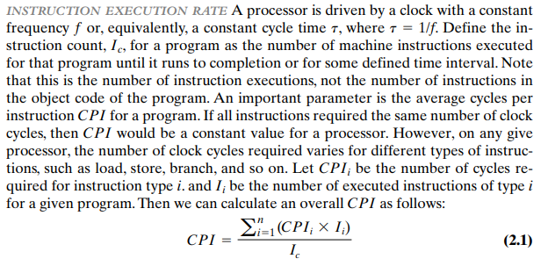
Instruction Execution Rate

Slide 13
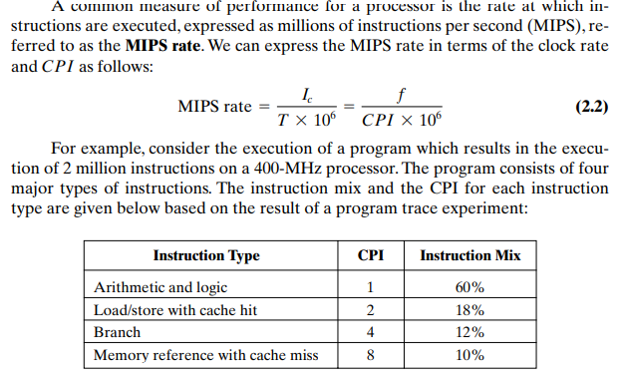

Slide 14


Slide 15
Benchmarks
Programs designed to test performance
Written in high level language
Portable
Represents style of task
Systems, numerical, commercial
Easily measured
Widely distributed
E.g. System Performance Evaluation Corporation (SPEC)
CPU2006 for computation bound
17 floating point programs in C, C++, Fortran
12 integer programs in C, C++
3 million lines of code
Speed and rate metrics
Single task and throughput

Slide 16
Amdahl’s Law
Gene Amdahl [AMDA67]
Potential speed up of program using multiple processors
Concluded that:
Code needs to be parallelizable
Speed up is bound, giving diminishing returns for more processors
Task dependent
Servers gain by maintaining multiple connections on multiple processors
Databases can be split into parallel tasks

Slide 17
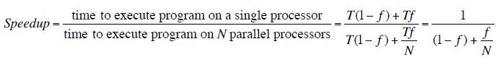
Amdahl’s Law Formula
For program running on single processor
Fraction f of code infinitely parallelizable with no scheduling overhead
Fraction (1-f) of code inherently serial
T is total execution time for program on single processor
N is number of processors that fully exploit parallel portions of code
Conclusions
f small, parallel processors has little effect
N ->∞, speedup bound by 1/(1 – f)
Diminishing returns for using more processors

Slide 18
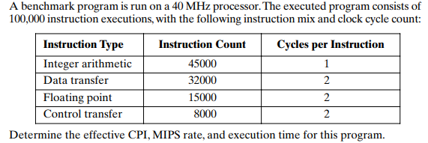
Problem

Slide 19
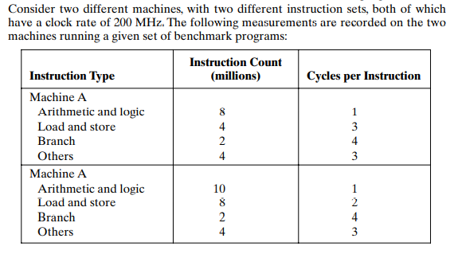
Problem

